Slide 1
Increment and decrement
export default class App extends Component {
state={
Num:0
}
increment = e => this.setState({Num: this.state.Num+1})
decrement = e => this.setState({Num: this.state.Num-1})
render= ()=>
<div className="App">
<h1> Initial Value: {this.state.Num}</h1>
<button onClick={this.increment}> Incremenet </button>
<button onClick={this.decrement}> Decremenet </button>
</div>
}

Slide 2
import React, { Component } from "react";
import axios from "axios";
class PostList extends Component {
constructor(props) {
super(props);
this.state = {
posts: []
};
}
componentDidMount() {
axios
.get("https://jsonplaceholder.typicode.com/posts")
.then((response) => {
//console.log(response);
this.setState({ posts: response.data });
})
.catch((error) => {
console.log(error);
});
}
render() {
const { posts } = this.state;
return (
<div className="App">
<h1>List of Posts</h1>
{posts.length
? posts.map((post) => <div key={post.id}>{post.userId}</div>)
: null}
</div>
);
}
}
export default PostList;
import React from "react";
import PostList from "./Component/PostList";
export default function App() {
return (
<div className="App">
<PostList />
</div>
);
}
Get Request with Axios

Slide 3
import React, { Component } from "react";
import axios from "axios";
class PostForm extends Component {
constructor(props) {
super(props);
this.state = {
userId: "",
title: "",
body: ""
};
}
changeHandler = (e) => {
this.setState({ [e.target.name]: e.target.value });
};
submitHandler = (e) => {
e.preventDefault();
console.log(this.state);
axios.post("https://jsonplaceholder.typicode.com/posts", this.state)
.then((response)=>{console.log(response)})
.catch(error=>{console.log(error)})
};
render() {
const { userId, title, body } = this.state;
return (
<div className="App">
<form onSubmit={this.submitHandler}>
<div>
<input
type="text"
name="userId"
value={userId}
onChange={this.changeHandler}
></input>
</div>
<div>
<input
type="text"
name="title"
value={title}
onChange={this.changeHandler}
></input>
</div>
<div>
<input
type="text"
name="body"
value={body}
onChange={this.changeHandler}
></input>
</div>
<button type="submit">click me</button>
</form>
</div>
);
}
}
export default PostForm;
Post(add) using axios on console

Slide 4
import React from "react";
import "./styles.css";
import { connect } from "react-redux";
function App(props) {
console.log(props);
return (
<div className="App">
<h1>Hello React-Redux</h1>
<h1>My name is {props.myname}</h1>
<button
onClick={() => {
props.changeName("Suresh");
}}
>
Change Name
</button>
</div>
);
}
const mapStateToProp = (state) => {
return {
myname: state.name
};
};
const mapDispatchToProp = (dispatch) => {
return {
changeName: (name) => {dispatch({type: "CHANGE_NAME", payload: name});
}
};
};
export default connect(mapStateToProp, mapDispatchToProp)(App);
Redux
const iState = {
name: "Ramesh",
wish: ["eat", "code"]
};
const reducer = (state = iState, action) => {
console.log(action);
if (action.type === "CHANGE_NAME") {
return {
...state,
name: action.payload
};
}
return state;
};
export default reducer;
import React from "react";
import ReactDOM from "react-dom";
import App from "./App";
import { createStore } from "redux";
import { Provider } from "react-redux";
import reducer from "./Reducers/Reducers";
const store = createStore(reducer,
window.__REDUX_DEVTOOLS_EXTENSION__ && window.__REDUX_DEVTOOLS_EXTENSION__());
const rootElement = document.getElementById("root");
ReactDOM.render(
<Provider store={store}>
<App />
</Provider>,
rootElement
);

Slide 5
import React from "react";
import "./styles.css";
import { connect } from "react-redux";
import { anotherName } from "./Action/Action";
function App(props) {
console.log(props);
return (
<div className="App">
<h1>Hello React-Redux</h1>
<h1>My name is {props.myname}</h1>
<button
onClick={() => {
props.changeName();
}}
>
Change Name
</button>
</div>
);
}
const mapStateToProp = (state) => {
return {
myname: state.name
};
};
const mapDispatchToProp = (dispatch) => {
return {
changeName: () => {
dispatch(anotherName());
}
};
};
export default connect(mapStateToProp, mapDispatchToProp)(App);
import React from "react";
import ReactDOM from "react-dom";
import App from "./App";
import { createStore } from "redux";
import { Provider } from "react-redux";
import reducer from "./Reducers/Reducers";
import { applyMiddleware } from "redux";
import thunk from "redux-thunk";
const store = createStore(reducer, applyMiddleware(thunk));
const rootElement = document.getElementById("root");
ReactDOM.render(
<Provider store={store}>
<App />
</Provider>,
rootElement
);
export const anotherName = () => {
return async (dispatch) => {
const data = await fetch ("https://jsonplaceholder.typicode.com/users");
const res = await data.json()
dispatch({ type: "CHANGE_NAME", payload: res[0].name
});
};
};
const iState = {
name: "Ramesh",
wish: ["eat", "code"]
};
const reducer = (state = iState, action) => {
console.log(action);
if (action.type === "CHANGE_NAME") {
return {
...state,
name: action.payload
};
}
return state;
};
export default reducer;
Using Action Creator

Slide 6
App: import React from "react"; import "./styles.css"; import { connect } from "react-redux"; import { anotherName, addWish } from "./Action/Action"; function App(props) { const mywish = props.mywish.map(item=>{ return <h2 key={Math.random()}> {item}</h2> }) console.log(props); return ( <div className="App"> <h1>Hello React-Redux</h1> <h1>My name is {props.myname}</h1> {mywish} <button onClick={() => { props.changeName(); }} > Change Name </button> <button onClick={() => { props.addWish(); }} > Add Wish </button> </div> ); } const mapStateToProp = (state) => { return { myname: state.name, mywish : state.wish }; }; const mapDispatchToProp = (dispatch) => { return { changeName: () => { dispatch(anotherName())}, addWish: () => { dispatch(addWish())} } } export default connect(mapStateToProp, mapDispatchToProp)(App); | Index: import React from "react"; import ReactDOM from "react-dom"; import App from "./App"; import { createStore } from "redux"; import { Provider } from "react-redux"; import { applyMiddleware } from "redux"; import thunk from "redux-thunk"; import { combineReducers } from "redux"; import nameReducer from './Reducers/nameReducers'; import wishReducer from './Reducers/wishReducers'; const masterReducer = combineReducers({ name: nameReducer, wish: wishReducer }) const store = createStore(masterReducer,{name: 'Ramesh', wish:['eat', 'sleep']}, applyMiddleware(thunk)); const rootElement = document.getElementById("root"); ReactDOM.render( <Provider store={store}> <App /> </Provider>, rootElement ); | nameReducer: const iState = { name: "Ramesh", wish: ["eat", "code"] }; const reducer = (state = iState, action) => { console.log(action); if (action.type === "CHANGE_NAME") { return { ...state, name: action.payload }; } return state; }; export default reducer; | wishReducer: const wishReducer = (state = [], action) => { if (action.type === "ADD_WISH") { return [...state, action.payload] } return state; }; export default wishReducer | Action.js: export const anotherName = () => { return async (dispatch) => { const data = await fetch("https://jsonplaceholder.typicode.com/users"); const res = await data.json() dispatch({ type: "CHANGE_NAME", payload: res[0].name }); }; }; export const addWish = () => { return {type:'ADD_WISH', payload: 'drink'} };

Slide 7
Timer
import React from "react";
import "./styles.css";
class App extends React.Component {
constructor(props) {
super(props);
this.state = { seconds: 0 };
}
tick() {
this.setState((state) => ({seconds: state.seconds + 1}));
}
componentDidMount() {
setInterval(() => this.tick(), 1000);
}
render() {
return (
<div>
Seconds: {this.state.seconds}
</div>
);
}
}
export default App;

Slide 8
import React from "react";
import "./styles.css";
class App extends React.Component {
constructor(props) {
super(props);
this.state = { items: [], text: "" };
}
render() {
return (
<div>
<h3>TODO</h3>
<TodoList items={this.state.items} />
<form onSubmit={this.handleSubmit}>
<label htmlFor="new-todo">What needs to be done?</label>
<input
id="new-todo"
onChange={this.handleChange}
value={this.state.text}
/>
<button>Add #{this.state.items.length + 1}</button>
</form>
</div>
);
}
handleChange=(e)=> {
this.setState({ text: e.target.value });
}
handleSubmit=(e)=> {
e.preventDefault();
if (this.state.text.length === 0) {
return;
}
this.setState((state) => ({
items: state.items.concat({ text: this.state.text}),
text: ""})
);
}
}
class TodoList extends React.Component {
render() {
return (
<ol>
{this.props.items.map((item) => (
<li key={item.id}>{item.text}</li>
))}
</ol>
);
}
}
export default App;
To DO LIST

Slide 9
Dropdown value
import React from "react";
import "./styles.css";
class App extends React.Component {
constructor(props) {
super(props);
this.state = { value: "" };
}
handleChange = (event) => {
this.setState({ value: event.target.value });
};
handleSubmit = (event) => {
alert("Your favorite flavor is: " + this.state.value);
event.preventDefault();
};
render() {
return (
<form onSubmit={this.handleSubmit}>
<label> Pick your favorite flavor: </label>
<select value={this.state.value} onChange={this.handleChange}>
<option value="grapefruit">Grapefruit</option>
<option value="lime">Lime</option>
<option value="coconut">Coconut</option>
<option value="mango">Mango</option>
<option value="banana">banana</option>
</select>
<button type="submit" value="Submit">Submit</button>
</form>
);
}
}
export default App;

Slide 10
Increment using hook
import React, { useState } from "react";
function App() {
const [count, setCount] = useState(0);
return (
<div>
<button onClick={() => setCount(count + 1)}>Click me</button>
<p>You clicked {count} times.</p>
</div>
);
}
export default App;

Slide 11
class App extends Component {
render() {
return (
<table style={{color: "Black", border:"3px solid Black"}}>
<thead >
<tr >
<th style={{color: "red", border:"3px solid blue"}}>Name</th>
<th style={{color: "red", border:"3px solid blue"}}>Job</th>
</tr>
</thead>
<tbody>
<tr>
<td style={{color: "red", border:"3px solid blue"}}>Dee</td>
<td style={{color: "red", border:"3px solid blue"}}>Aspiring actress</td>
</tr>
<tr>
<td style={{color: "red", border:"3px solid blue"}}>Dennis</td>
<td style={{color: "red", border:"3px solid blue"}}>Bartender</td>
</tr>
</tbody>
</table>
)
}
}
Table

Slide 12
Parent to child
import React, { Component } from "react";
import Child1 from "./Child1";
class Parent extends Component {
state =
{description: "Value From Parent"};
render() {
return (
<div>
<Child1 valueFromParent={this.state.description} />
</div>
);
}
}
export default Parent;
import React, { Component } from "react";
import Parent from "./components/Parent";
class App extends Component {
render() {
return (
<div className="App">
<Parent />
</div>
);
}
}
export default App;
import React, { Component } from "react";
class Child1 extends Component {
render() {
return (
<div>
<h2>{this.props.valueFromParent}</h2>
</div>
);
}
}
export default Child1;

Slide 13
import React, { Component } from "react";
class Child extends Component {
constructor(props) {
super(props);
this.state = {
inputVal: ""
};
this.onInputChange = this.onInputChange.bind(this);
this.hanldeSubmit = this.hanldeSubmit.bind(this);
}
onInputChange=(e)=> {
this.setState({ inputVal: e.target.value });
}
hanldeSubmit=()=> {
this.props.handleInput(this.state.inputVal);
}
render() {
return (
<div>
<h3>Child Component</h3>
<input
type="text"
value={this.state.inputVal}
onChange={this.onInputChange}
/>
<input type="button" value="Submit" onClick={this.hanldeSubmit} />
</div>
);
}
}
export default Child;
Child to Parent
import React, { Component } from "react";
import Child from "./Child";
class App extends Component {
constructor(props) {
super(props);
this.state = {
inputVal: ""
};
this.handleInputValue = this.handleInputValue.bind(this);
}
handleInputValue(val) {
this.setState({ inputVal: val });
}
render() {
return (
<div>
<Child handleInput={this.handleInputValue} />
<h3>Parent Component Input Value: {this.state.inputVal}</h3>
</div>
);
}
}
export default App;

Slide 14
A = [“Adffs”,”fsfsf”]
Import React from “react”
Class Fetch extend React.Component{
constructor(props){
super(props)
state={
A = [“Adffs”,”fsfsf”]
}
}
render(){
return(
<h1> Values are{this.state.A)}</h1>
)
}
export default Fetch
var arrayList = ['a','b','c','d','e','f'];
arrayList.splice(0, arrayList.length);
var a = {a: 1};
var b = {a: 1};
a == b
a === b
var string = "Welcome to this Javascript Guide!";
if(noOfChar >5){
}
4+3+2+"1" = 91
+"1"+4+3+2 = 1432
var firstWord = "Mary";
var secondWord = "Army";

Slide 15
Anagram
var firstWord = "Mary";
var secondWord = "Army";
console.log(isAnagram(firstWord, secondWord)); // true
function isAnagram(first, second) {
// For case insensitivity, change both words to lowercase.
var a = first.toLowerCase();
var b = second.toLowerCase();
// Sort the strings, and join the resulting array to a string. Compare the results
a = a.split("").sort().join("");
b = b.split("").sort().join("");
return a === b;
}

Slide 16
Array Print
import React from "react";
import "./styles.css";
export default function App() {
const reptiles = ["alligator", "snake", "lizard"];
return (
<div>
<ol>
{reptiles.map(
(reptile) => (<li key={Math.random()}>{reptile}</li>)
)}
</ol>
</div>
);
}

Slide 17
Given a string, reverse each word in the sentence
var string = "Welcome to this Javascript Guide!";
var reverseEntireSentence = reverseBySeparator(string, ""); // Output becomes !ediuG tpircsavaJ siht ot emocleW
var reverseEachWord = reverseBySeparator(reverseEntireSentence, " "); // Output becomes emocleW ot siht tpircsavaJ !ediuG
function reverseBySeparator(string, separator) {
return string.split(separator).reverse().join(separator);

Slide 18
How would you check if a number is an integer?
A very simple way to check if a number is a decimal or integer is to see if there is a remainder left when you divide by 1.
function isInt(num) {
return num % 1 === 0;
}
console.log(isInt(4)); // true
console.log(isInt(12.2)); // false
console.log(isInt(0.3)); // false

Slide 19
What will be the output of the following code?
var y = 1;
if (function f() {}) {
y += typeof f;
}
console.log(y);
Above code would give output 1undefined. If condition statement evaluate using eval so eval(function f() {}) which return function f() {}
which is true so inside if statement code executes. typeof f return undefined because if statement code executes at run time,
so statement inside if condition evaluated at run time.

Slide 20
What will the following code output?
(function() {
var a = b = 5;
})();
console.log(b);
The code above will output 5

Slide 21
Palindrome !!
Palindrome Problem
A palindrome is a word, sentence, or other types of character sequence that reads the same backward as forward.
For example, “racecar” and “Anna” are palindromes. “Table” and “John” aren’t palindromes, because they don’t read the same from left to right and from right to left.
const palindrome = str => {
// turn the string to lowercase
str = str.toLowerCase()
// reverse input string and return the result of the
// comparisong
return str === str.split('').reverse().join('')
}

Slide 22
Find the no. of vowels:
Str= “kjgjhgjhgkgkjgkhl”
const findVowels = str => {
let count = 0
const vowels = ['a', 'e', 'i', 'o', 'u’]
for(let character of str.toLowerCase())
{if(vowels.includes(character))
{count++}
}
return count
}

Slide 23
https://www.fullstack.cafe/blog/javascript-code-interview-questions
https://github.com/ganqqwerty/123-Essential-JavaScript-Interview-Questions/blob/master/README.md
https://github.com/tianp/101-JavaScript-Interview-Question
https://www.designmycodes.com/javascript/javascript-interview-questions.html
https://www.toptal.com/javascript/interview-questions
https://www.interviewbit.com/javascript-interview-questions/
https://www.thatjsdude.com/interview/js2.html
https://www.designmycodes.com/javascript/javascript-tricky.html
https://www.fullstack.cafe/blog/javascript-code-interview-questions
http://www.lib4dev.in/info/kennymkchan/interview-questions-in-javascript/53985630
https://www.codegrepper.com/code-examples/html/react+add+button+to+form+control

Slide 24
ROUTER
import React, { Component } from "react";
import { BrowserRouter as Router, Switch, Route, Link } from "react-router-dom";
import Home from "./Home";
import About from "./About";
import Contact from "./Contact";
class App extends Component {
render() {
return (
<Router>
<div>
<h2>Welcome to React Router Tutorial</h2>
<nav className="navbar navbar-expand-lg navbar-light bg-light">
<ul className="navbar-nav mr-auto">
<li><Link to={"/"}> Home</Link></li>
<li><Link to={"/contact"} >Contact</Link></li>
<li><Link to={"/about"} >About</Link></li>
</ul>
</nav>
<hr />
<Switch>
<Route exact path="/" component={Home} />
<Route path="/contact" component={Contact} />
<Route path="/about" component={About} />
</Switch>
</div>
</Router>
);
}
}
export default App;
import React, { Component } from "react";
class About extends Component {
render() {
return (
<div>
<h2 style={{ color: "red" }}>About Page</h2>
</div>
);
}
}
export default About;

Slide 25
All data at console
import React from "react";
class App extends React.Component {
componentDidMount() {
fetch("https://api.github.com/users/hacktivist123/repos")
.then((response) => response.json())
.then((data) => console.log("This is your data", data));
}
render() {
return <h1>my Component has Mounted, Check the browser 'console' </h1>;
}
}
export default App;

Slide 26
import React from "react";
class App extends React.Component {
state = {
loading: true,
person: null
};
async componentDidMount() {
const url = "https://api.randomuser.me/";
const response = await fetch(url);
const data = await response.json();
this.setState({
person: data.results[0],
loading: false
});
console.log(data);
}
render() {
return (
<div>
{this.state.loading || !this.state.person ? (
<div>Loading..</div>
) : (
<div>
<div>{this.state.person.gender}</div>
<div>{this.state.person.name.first}</div>
<div>{this.state.person.name.last}</div>
<div>{this.state.person.location.city}</div>
<img src={this.state.person.picture.large} />
</div>
)}
</div>
);
}
}
export default App;
import React from "react";
class App extends React.Component {
constructor() {
super();
this.state = {
data: []
};
}
componentDidMount() {
fetch("https://reactnative.dev/movies.json")
.then((response) => response.json())
.then((findresponse) => {
console.log(findresponse.movies);
this.setState({ data: findresponse.movies });
});
}
render() {
return (
<div>
{this.state.data.map((dynamicData, key) => (
<div>
{dynamicData.id},{dynamicData.title},{dynamicData.releaseYear}
<hr />
</div>
))}
</div>
);
}
}
export default App;
Fetch

Slide 27
Fetch Data: Success
import React from "react";
class App extends React.Component {
constructor() {
super();
this.state = {
ttl: "",
desc: "",
mv: []
};
}
componentDidMount() {
fetch("https://reactnative.dev/movies.json")
.then((response) => response.json())
.then((findresponse) => {
console.log(findresponse);
//console.log(findresponse.title);
//console.log(findresponse.description);
//console.log(findresponse.movies);
this.setState({
ttl: findresponse.title,
desc: findresponse.description,
mv: findresponse.movies
});
});
}
render() {
return (
<div>
<h3>{this.state.ttl}</h3>
<h4>{this.state.desc}</h4>
<h5>
{this.state.mv.map((EachValueOfArray, key) => (
<div style={{color:"red"}}>
{EachValueOfArray.id},{EachValueOfArray.title},{EachValueOfArray.releaseYear}
<hr />
</div>
))}
</h5>
</div>
);
}
}
export default App;
import React from "react";
class App extends React.Component {
constructor() {
super();
this.state = {
name: "",
email: ""
};
}
componentDidMount() {
fetch("https://jsonplaceholder.typicode.com/users")
.then((response) => response.json())
.then((findresponse) => {
console.log(findresponse);
//console.log(findresponse[0].name);
this.setState({ name: findresponse[0].name, email: findresponse[0].email });
});
}
render() {
return (
<div>
<h3>{this.state.name}</h3>
<h4>{this.state.email}</h4>
</div>
);
}
}
export default App;
import React from "react";
class App extends React.Component {
constructor() {
super();
this.state = {
data:[]
};
}
componentDidMount() {
fetch("https://jsonplaceholder.typicode.com/users")
.then((response) => response.json())
.then((findresponse) => {
console.log(findresponse);
//console.log(findresponse[0].name);
this.setState({
data: findresponse });
});
}
render() {
return (
<div>
<h4>{this.state.data.map((eachValue, key)=>
(<div>{eachValue.name}, {eachValue.email}, {eachValue.phone}</div>))
}</h4>
</div>
);
}
}
export default App;

Slide 28
import React, { Component } from "react";
class ClickCounter extends Component {
constructor(props) {
super(props);
this.state = {
count: 0
};
}
increment = () => {
this.setState((prestate) => {
return { count: prestate.count + 1 };
});
};
render() {
const { count } = this.state;
return <button onClick={this.increment} >Clicked {count} times </button>;
}
}
export default ClickCounter;
Counter on button

Slide 29
import { Component } from "react";
import React from "react";
class ErrorBoundary extends Component {
constructor() {
super();
this.state = {
hasError: false
};
}
static getDerivedStateFromError(error) {
return { hasError: true };
}
componentDidCatch(error, info) {
console.log(error);
console.log(info);
}
render() {
if (this.state.hasError) {
return <h4>Something wrong !</h4>;
}
return this.props.children;
}
}
export default ErrorBoundary;
Error Boundary
import React from "react";
import "./styles.css";
import Hero from "./Hero";
import ErrorBoundary from "./ErrorBoundary";
export default function App() {
return (
<div className="App">
<ErrorBoundary>
<Hero heroName="Batman" />
<Hero heroName="Superman" />
<Hero heroName="Joker" />
</ErrorBoundary>
</div>
);
}
import React from "react";
import "./styles.css";
export default function Hero({ heroName }) {
if (heroName === "Joker") {
throw new Error("not a heroooo");
}
return <div>{heroName}</div>;
}
Pure Components allow re-render only if there is a diff in shallow comparison of state and props. It is used with class component only.

Slide 30
Write a JavaScript function to check whether an 'input' is an array or not.
is_array = function(input) {
if (toString.call(input) === "[object Array]")
return true;
return false;
};
console.log(is_array('resource'));
console.log(is_array([1, 2, 4, 0]));

Slide 31
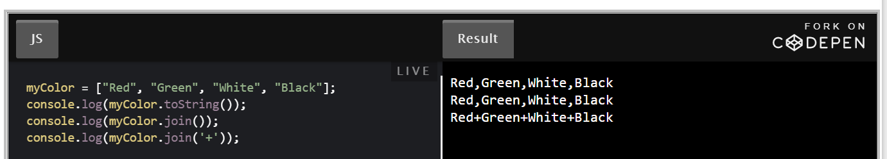
Get the first element of an array
first = function(array, n) {
if (array == null)
return void 0;
if (n == null)
return array[0];
if (n < 0)
return [];
return array.slice(0, n);
};
console.log(first([7, 9, 0, -2]));
console.log(first([],3));
console.log(first([7, 9, 0, -2],3));
console.log(first([7, 9, 0, -2],6));

Slide 32
Write a JavaScript program which accept a string as input and swap the case of each character. For example if you input 'The Quick Brown Fox' the output should be 'tHE qUICK bROWN fOX'.
str = 'My Name is Priya 98';
var UPPER = 'ABCDEFGHIJKLMNOPQRSTUVWXYZ';
var LOWER = 'abcdefghijklmnopqrstuvwxyz';
var result = [];
for(var x=0; x<str.length; x++)
{
if(UPPER.indexOf(str[x]) !== -1)
{
result.push(str[x].toLowerCase());
}
else if(LOWER.indexOf(str[x]) !== -1)
{
result.push(str[x].toUpperCase());
}
else
{
result.push(str[x]);
}
}
console.log(result.join(''));

Slide 33
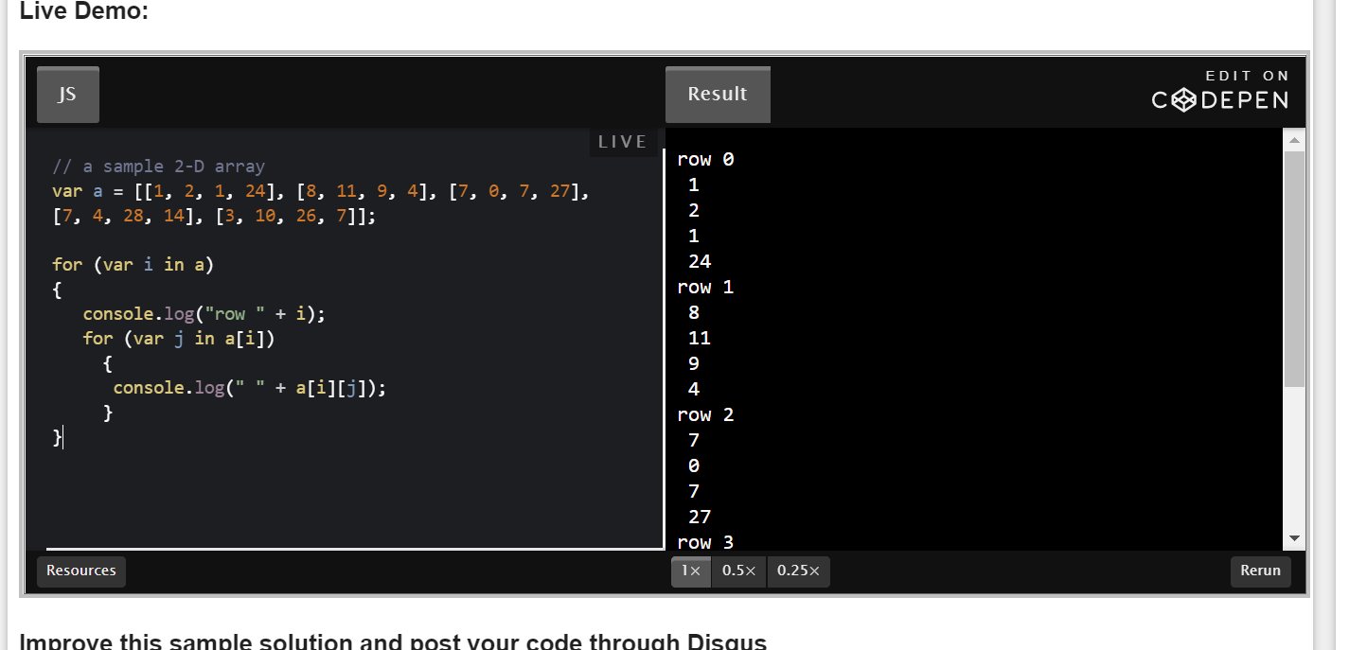
Write a JavaScript program which prints the elements of the following array:

Slide 34
Find the sum of squares
function sum_sq(array) {
var sum = 0,
i = array.length;
while (i--)
sum += Math.pow(array[i], 2);
return sum;
}
console.log(sum_sq([0,1,2,3,4]));

Slide 35
Compute the sum and product of an array of integers
var array = [1, 2, 3, 4, 5, 6],
s = 0,
p = 1,
i;
for (i = 0; i < array.length; i += 1)
{
s += array[i];
p *= array[i];
}
console.log('Sum : '+s + ' Product : ' +p);

Slide 36
Write a JavaScript program to remove duplicate items from an array.
Write a JavaScript program to compute the union of two arrays.
Write a JavaScript function to remove. 'null', '0', '""', 'false', 'undefined' and 'NaN' values from an array.
Write a JavaScript function to find the longest common starting substring in a set of strings
Write a JavaScript function to get nth largest element from an unsorted array.
Find the longest common starting substring in a set of strings
Remove null, 0, blank, false, undefined and NaN values from an array
Compute the union of two arrays

Slide 37
import java.util.Arrays;
public class SortArrayExample1
{
public static void main(String[] args)
{
//defining an array of integer type
int [] array = new int [] {90, 23, 5, 109, 12, 22, 67, 34};
//invoking sort() method of the Arrays class
Arrays.sort(array);
System.out.println("Elements of array sorted in ascending order: ");
//prints array using the for loop
for (int i = 0; i < array.length; i++)
{
System.out.println(array[i]);
//console.log(array[i])
}
}
}

Slide 38
Use filter + indexOf
function uniqueArray3(a) { function onlyUnique(value, index, self) { return self.indexOf(value) === index; } // usage var unique = a.filter( onlyUnique ); // returns ['a', 1, 2, '1'] return unique; }
Use ES6 [...new Set(a)]
function uniqueArray4(a) { return [...new Set(a)]; }
Unquie value

Slide 39
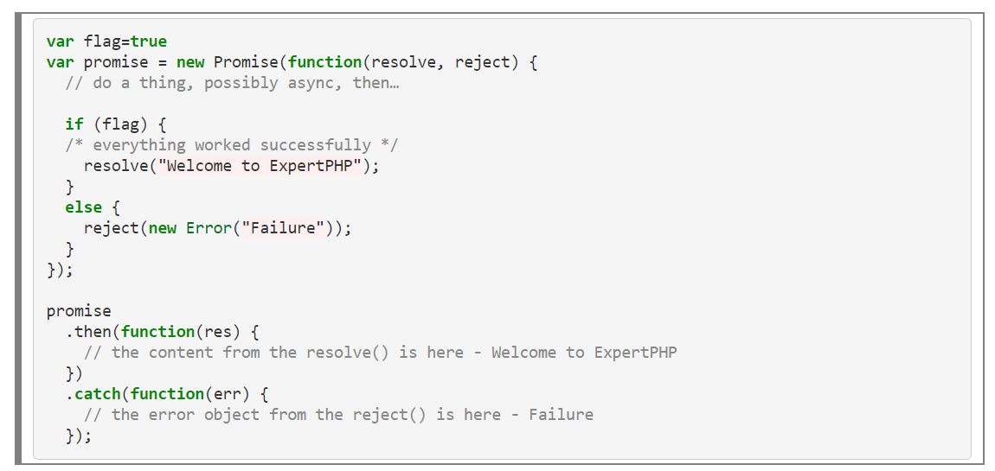
Promises

Slide 40
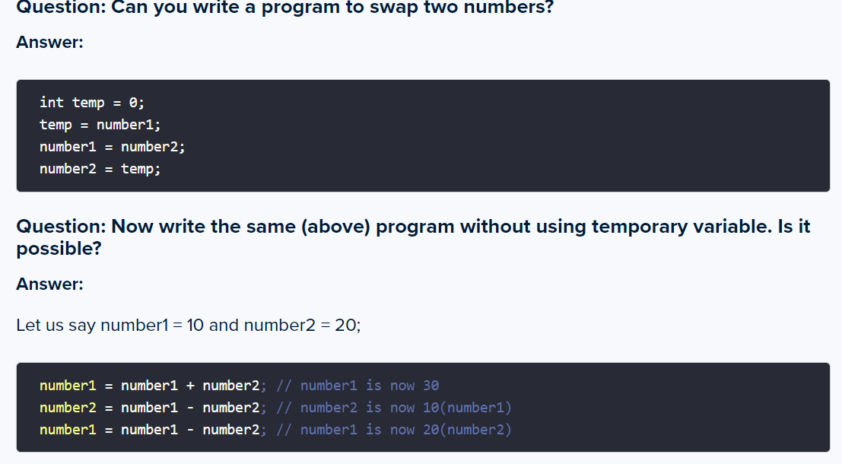
What is SDLC?
Answer: Software Development Life Cycle (SDLC) is an end to end process that defines the flow of the development of a project from requirements stage to the maintenance and support stage. The stages in SDLC are requirements analysis, planning, definition, design, development, testing, deployment, and support (maintenance).

Slide 41
import React from "react";
import { BrowserRouter, Switch, Route } from "react-router-dom";
import Login from "./Login";
import Dashboard from "./Dashboard";
import Home from "./Home";
function App() {
return (
<div className="App">
<BrowserRouter>
<div>
<div className="content">
<Switch>
<Route exact path="/" component={Home} />
<Route path="/login" component={Login} />
<Route path="/dashboard" component={Dashboard} />
</Switch>
</div>
</div>
</BrowserRouter>
</div>
);
}
export default App;

Slide 42
Way to navigate from one page to another page
Link
NavLink
Redirect Component
history.push
history.replace

Slide 43
import React, { useState } from "react";
function Login(props) {
const username = useFormInput("");
const password = useFormInput("");
const [error, setError] = useState(null);
const [loading, setLoading] = useState(false);
const handleLogin = () => {
props.history.push("/dashboard");
};
return (
<div>
Login:<br /><hr />
Username <input type="text" /><br />
Password <input type="password" /><br />
<input type="button"
value={loading ? "Loading..." : "Login"}
onClick={handleLogin}
enabled={loading}/>
</div>
);
}
const useFormInput = (initialValue) => {
const [value, setValue] = useState(initialValue);
const handleChange = (e) => {setValue(e.target.value)};
return { value, onChange: handleChange};
};
export default Login;
import React from "react";
function Dashboard(props) {
const handleLogout = () => {
props.history.push("/Login");
};
return (
<div>
Welcome After Login To the DashBoard !<br />
<br />
<input type="button" onClick={handleLogout} value="Logout (back to login)" />
</div>
);
}
export default Dashboard;

Slide 44
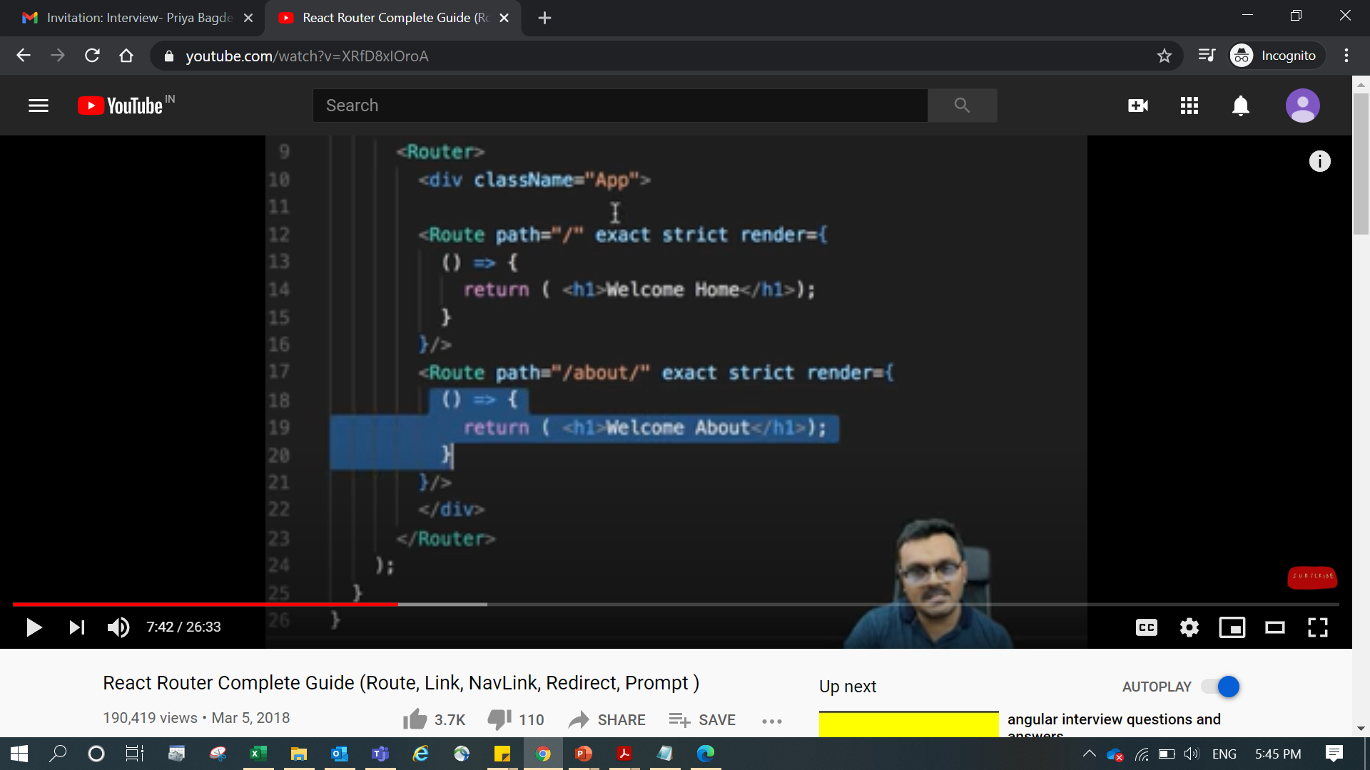

Slide 45
mport React from "react";
import "./styles.css";
import { withRouter } from "react-router-dom";
class Login extends React.Component {
constructor() {
super();
this.state = {
err: ""
};
this.login = this.login.bind(this);
}
login(e) {
e.preventDefault();
var username = e.target.elements.username.value;
var password = e.target.elements.password.value;
if (username && password) {
this.props.history.push("/welcome/" + username);
} else {
this.setState((er) => {
return { err: "Invalid" };
});
}
}
render() {
return (
<div>
<h3>Login</h3>
<span style={{ color: "red" }}>
{this.state.err !== "" ? this.state.err : ""}
</span>
<form method="post" onSubmit={this.login.bind(this)}>
Username: <input type="text" name="username" />
Password: <input type="password" name="password" />
<button type="submit" value="Login">
Login Please
</button>
</form>
</div>
);
}
}
export default withRouter(Login);
import "./styles.css";
import { BrowserRouter, Switch, Route } from "react-router-dom";
import Login from "./Login";
import Welcome from "./Welcome";
export default class App extends React.Component {
render() {
return (
<BrowserRouter>
<Switch>
<Route exact path="/" component={Login} />
<Route exact path="/welcome/:username" component={Welcome} />
<Route exact path="/logout" component={Login} />
</Switch>
</BrowserRouter>
);
}
}
import React from "react";
import "./styles.css";
export default class Welcome extends React.Component {
logout() {
this.props.history.push("/logout");
}
render() {
const { username } = this.props.match.params;
console.log(username);
return (
<div className="App">
<h4> Welcome {username}</h4>
<button onClick={this.logout.bind(this)}></button>
</div>
);
}
}

Slide 46
React Fiber is a completely backward-compatible rewrite of the old reconciler. This new reconciliation algorithm from React is called Fiber Reconciler. The name comes from fiber, which it uses to represent the node of the DOM tree. We will go through fiber in detail in later sections.
The main goals of the Fiber reconciler are incremental rendering, better or smoother rendering of UI animations and gestures, and responsiveness of the user interactions. The reconciler also allows you to divide the work into multiple chunks and divide the rendering work over multiple frames. It also adds the ability to define the priority for each unit of work and pause, reuse, and abort the work.
Inheritance refers to an object's ability to access methods and other properties from another object. Objects can inherit things from other objects. Inheritance in JavaScript works through something called prototypes and this form of inheritance is often called prototypal inheritance.
Variable Hoisting
In terms of variables and constants, keyword var is hoisted and let and const does not allow hoisting.
For example,
// program to display value a = 5; console.log(a); var a; // 5

Slide 47
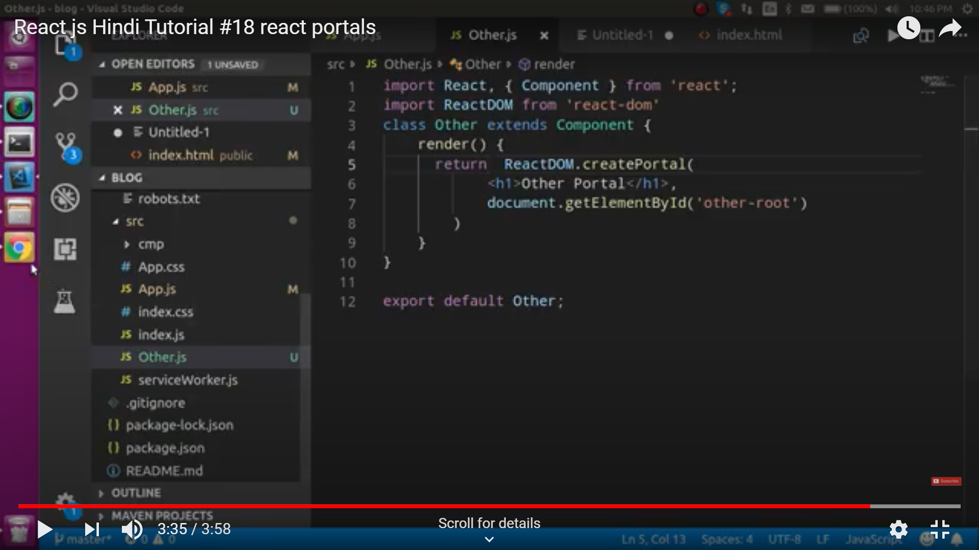

Slide 48
How to use InnerHtml in React?
This rule applies when innerHTML prop for a React DOM element is used.
innerHTML prop is risky because it is easy to expose your users to a cross-site scripting (XSS) attack. React provides dangerouslySetInnerHTML as a replacement for innerHTML prop to remind yourself that it is dangerous.
Therefore, you should use dangerouslySetInnerHTML prop instead of innerHTML prop. Otherwise, React outputs a warning message.
<div dangerouslySetInnerHTML={{ __html: "Hello" }} />,

Slide 49
How to use styles in React?
CSS Stylesheet: Having Separate file for each componenet
Inline styling: specified with an object whose key is the camelCased version of the style name, and whose value is the style’s value, usually a string
CSS Modules: A CSS Module is a CSS file in which all class names and animation names are scoped locally by default.
Styled-components: it is a library for React and React Native that allows you to use component-level styles in your application that are written with a mixture of JavaScript and CSS
How events are handled in react?
Handling events with React elements is very similar to handling events on DOM elements. There are some syntax differences: React events are named using camelCase, rather than lowercase. With JSX you pass a function as the event handler, rather than a string.
How you use decorators In react?
Decorators in React help you take an existing Class component, or function of a Class component, and modify it, thereby allowing you to add extra capabilities, without having to mess with the existing codebase. Modification can be overriding the existing function completely, or just adding extra logic to it.
A Decorator is a special kind of declaration that can be applied to classes, methods, accessor, property, or parameter. Decorators are simply functions that are prefixed @expression symbol, where expression must evaluate to a function that will be called at runtime with information about the decorated declaration.

Slide 50
How to enable production mode in React?
to create a development bundle:
npm run dev
Production bundle:
npm run build
How to use React label element?
<label htmlFor="myInput">My Input</label> <input id="myInput" type="text" />

Slide 51
CSS | CSS3
W3C developed the first version of CSS in 1996. | CSS3 is the latest version of CSS released in the year 2005.
It doesn’t support media queries. | For responsive web designing, it supports media queries.
New web browsers do not support CSS. | New Web browsers support CSS3.
CSS isn’t compatible with CSS3. | CSS3 is backwards compatible even with CSS.
CSS uses an old standard colour format. | CSS3 provides a different gradient colour and schemes like RGBA, HSLA, HSL, and other colour gradients.
CSS does not have the concept of modules. | CSS3 incorporates a new feature where it can group CSS codes into convenient modules. Modules ensure that all styles for a specific component will reside in one place.

Slide 52
Call: call invokes the function and allows you to pass arguments one by one
Apply: Apply invokes the function and allows you to pass arguments as an array
Bind: Bind returns a new function, allowing you to pass in a this array and any number of arguments.
<article>
<aside>
<details>
<figcaption>
<figure>
<footer>
<header>
<main>
<mark>
<nav>
<section>
<summary>
<time>
Non-semantic elements tells nothing about its content.
Difference between call and apply is just that apply accepts parameters in the form of an array while call simply can accept a comma separated list of arguments.
what is JS Bind function?
A bind function is basically which binds the context of something and then stores it into a variable for execution at a later stage.

Slide 53
import React, { useEffect, useState } from "react";
import "./styles.css";
import Receipe from "./Receipe";
const App = () => {
const APP_ID = "4cd49911";
const APP_KEY = "7adee669af1755bb89fde7c5c38dd9ad";
const req =
"https://api.edamam.com/search?q=${query}&app_id=${APP_ID}&app_key=${APP_KEY}";
const [receipes, setReceipes] = useState([]);
const [search, setSearch] = useState("");
const [query, setQuery] = useState("chicken");
useEffect(() => {
getRecipes();
}, [query]);
const getRecipes = async () => {
const response = await fetch(req);
const data = await response.json();
setReceipes(data.hits);
console.log(data.hits);
};
const updateSearch = (e) => {
setSearch(e.target.value);
console.log(search);
};
const getSearch = (e) => {
e.preventDefault();
setQuery(search);
setSearch("");
};
return (
<div className="App">
<form className="search-form" onSubmit={getSearch}>
<input
className="search-bar"
type="text"
value={search}
onChange={updateSearch}
/>
<button className="search-button" type="submit">
{" "}
Search{" "}
</button>
</form>
{receipes.map((recipe) => (
<Receipe
key={recipe.recipe.label}
title={recipe.recipe.label}
calories={recipe.recipe.calories}
image={recipe.recipe.image}
ingredients={recipe.recipe.ingredients}
/>
))}
</div>
);
};
export default App;
import React from "react";
const Receipe = ({ title, calories, image, ingredients }) => {
return (
<div>
<h3> {title} </h3>
<ol>
{ingredients.map((ingredient) => (
<li>{ingredient.text}</li>
))}
</ol>
<p> {calories} </p>
<img src={image} alt="" />
</div>
);
};
export default Receipe;
https://www.youtube.com/watch?v=U9T6YkEDkMo

Slide 54
Interview Questions
javascrips objects
classes and inheritance in js
pre defined functions in js
event looping
mech of js,
what is asyn
arrow fuctions / normal function
es6 features
multi threading in js
what is constructor am ddefault value
what are classes in react-> function, class based
componets in react
life cycle methods
depricated methods
best method to call api
differ between in life cycles
props and state
HOC
how to implements and where to implement
redux , context api,
why redux
what is mapDispatchto props, mapStatetoprops, what are the parameters are acceping in connect
react router - version ?
Is it posible to transfer teh data from one componets without state and props. --- react router
how you will implement authenticate in reactjs
Middlewares
diff between thunk and saga
what are the side effects,
what is genarator functions
error handeling part
testing - tools.jest and enzyme
Server side redering
useState and useEffect
Authentication

Slide 55
Sumit Khatri
5:54 PM
[1,2,3,5,6,7,8,12,36,189]//
https://jsfiddle.net/
Sumit Khatri
6:02 PM
a = 15; var a;
console.log(a)
Sumit Khatri
6:05 PM
My name is priya
Ym eman si ayirp
Sumit Khatri
6:09 PM
<div onclick><p onclick><span onclick>
priya
</span></p></div
Sumit Khatri
6:12 PM
function changeStuff(a, b, c) { a = a * 10; b.item = "changed"; c = {item: "changed"}; }
var num = 10; var obj1 = {item: "unchanged"}; var obj2 = {item: "unchanged"};
changeStuff(num, obj1, obj2);
console.log(num); console.log(obj1.item); console.log(obj2.item);
Sumit Khatri
6:15 PM
[1,2,3,4,5,6,7,8,9]
[[1,8], [2,7]]
Sumit Khatri
6:19 PM
2+true+2+false+"true"
4+3+2+"1"
+"dude"
Sumit Khatri
6:20 PM
[1,2,3,4,5]
delete arr[4]
console.log(arr)
var arr1 = [54, 71, 58, 95, 20]; var arr2 = [71, 51, 54, 33, 80];
var uniqueArr = [];
Sumit Khatri
6:27 PM
const a = {b: {c: {d: 5}} }//console.log(a.b.c.d)

Slide 56
Reverse of each word in a string
function wordReverse(string){
return string.split(" ").reverse().join(" ").split("").reverse().join("")
}
console.log(wordReverse('My name is priya'))
function reverseWords (string) {
return string.split(" ")
.map(word => { return word.split("") .reverse() .join("") })
.join(" ");
}
const str = 'My Name is Priya';
console.log(reverseWords(str));

Slide 57
Print unique values:
function getUniqueAfterMerge(arr1, arr2){
let arr = [...arr1, ...arr2];
let uniqueArr = [...new Set(arr)];
console.log(uniqueArr);
}
const array1 = [1, 2, 3];
const array2 = [2, 3, 5]
getUniqueAfterMerge(array1, array2);

Slide 58
let result = undefined ?? "Hello"; console.log(result); // Hello
The nullish coalescing operator ( ?? ) is a logical operator that returns its right-hand side operand when its left-hand side operand is null or undefined , and otherwise returns its left-hand side operand.
const name = null ?? 'John’;
console.log(name); // 'John’

Slide 59
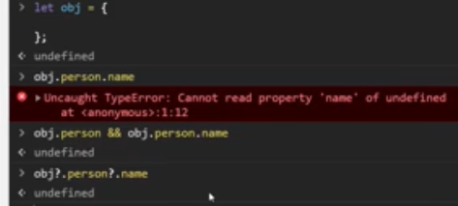

The optional chaining operator (?.) allows you to access the value of a property located deep within a chain of objects without explicitly checking if each reference in the chain is null or undefined.
The optional chaining ?. is a safe way to access nested object properties, even if an intermediate property doesn't exist.

Slide 60
function productOfArrayExceptSelf(array){
var resultArray = [], product;
for(var i = 0; i < array.length; i++){
product = 1;
for(var j = 0; j < array.length; j++){
if(i !== j) {product *= array[j]};
}
resultArray.push(product);
}
return resultArray;
}
var array = [1,2,3,4];
console.log(productOfArrayExceptSelf(array));
function findTriplets(arr, n) {
arr.sort();
for (var i = 0; i < arr.length; i++) {
var j = i + 1,
k = arr.length - 1;
while (j < k) {
if (arr[i] + arr[j] + arr[k] < n) {
j++;
} else if (arr[i] + arr[j] + arr[k] > n) {
k--;
} else {
console.log(arr[i] + "," + arr[j] + "," + arr[k]);
j++;
k--;
}
}
}
return true;
}
var arr = [-1, -4, -9, 0, 1, 2, 3, 4, 5, 6, 7, 8, 9];
findTriplets(arr, 0);

Slide 61
const number = parseInt(prompt('Enter the number of terms: '));
let n1 = 0, n2 = 1, nextTerm;
console.log('Fibonacci Series:');
for (let i = 1; i <= number; i++) {
console.log(n1);
nextTerm = n1 + n2;
n1 = n2;
n2 = nextTerm;
}
console.log(isPalindrome("racecar")); // true
console.log(isPalindrome("madam")); // true
function isPalindrome(word) {
// Replace all non-letter chars with "" and change to lowercase
var lettersOnly = word.toLowerCase().replace(/\s/g, "");
// Compare the string with the reversed version of the string
return lettersOnly === lettersOnly.split("").reverse().join("");
}
function reverseString(str) {
let newString = "";
for (let i = str.length - 1; i >= 0; i--) {
newString += str[i];
}
return newString;
}
const string = prompt('Enter a string: ');
console.log( reverseString(string))
var is_array = function(input) { if (toString.call(input) === "[object Array]") return true; return false; }; console.log(is_array('w3resource')); console.log(is_array([1, 2, 4, 0]));

Slide 62
function swap() {
var a=10, b=20;
a=a+b;//30
b=a-b;//10
a=a-b;//20
console.log("a="+a)
console.log("b="+b)
}
console.log( swap())
Multidimensional to single dimension:
var myArray=[1,2,3,4,[5,6,[7,8],9]]
var myNewArray4 = [].concat(...myArray);
var myNew= [].concat(...myNewArray4);
console.log(myNew);
Or
var myArray=[1,2,3,4,[5,6,[7,8],9]]
var myNewArray5 = myArray.flat(2);
console.log(myNewArray5);
Or
const arr4 = [1, 2, [3, 4, [5, 6, [7, 8, [9, 10]]]]];
arr4.flat(Infinity);
console.log(arr4.flat(Infinity));
Or
var myNewArray3 = []; for (var i = 0; i < myArray.length; ++i) { for (var j = 0; j < myArray[i].length; ++j) myNewArray3.push(myArray[i][j]); } console.log(myNewArray3);

Slide 63
Square Root of a Number
// take the input from the user const number = prompt('Enter the number: '); const result = Math.sqrt(number); console.log(`The square root of ${number} is ${result}`);
Addition of 2 no.s:
const num1 = 5;
const num2 = 3;
// add two numbers
const sum = num1 + num2;
// display the sum
console.log('The sum of ' + num1 + ' and ' + num2 + ' is: ' + sum);
OR
Area When Base and Height is Known
const baseValue = prompt('Enter the base of a triangle: '); const heightValue = prompt('Enter the height of a triangle: '); // calculate the area const areaValue = (baseValue * heightValue) / 2; console.log( `The area of the triangle is ${areaValue}` );
Area When All Sides are Known
// JavaScript program to find the area of a triangle const side1 = parseInt(prompt('Enter side1: ')); const side2 = parseInt(prompt('Enter side2: ')); const side3 = parseInt(prompt('Enter side3: ')); // calculate the semi-perimeter const s = (side1 + side2 + side3) / 2; //calculate the area const areaValue = Math.sqrt( s * (s - side1) * (s - side2) * (s - side3) ); console.log( `The area of the triangle is ${areaValue}` );
// store input numbers
const num1 = parseInt(prompt('Enter the first number '));
const num2 = parseInt(prompt('Enter the second number '));
//add two numbers
const sum = num1 + num2;
// display the sum
console.log(`The sum of ${num1} and ${num2} is ${sum}`);

Slide 64
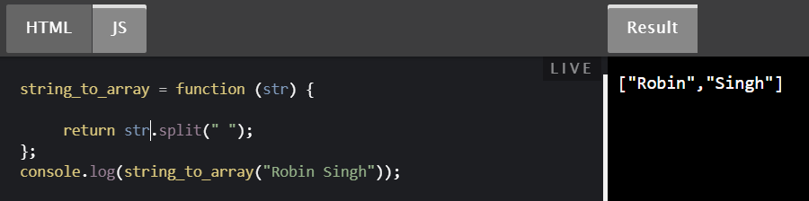
How to create a constant without using const keyword?
Constants in ECMA 5
We can create a constant in ECMA Script 5 using Object.defineProperty(). First we need to find out, whether variable would be a global variable or part of the window object. Once that is determined, create variable by setting writable to false.
Object.defineProperty(typeof global === "object" ? global : window, "foo", { value: 10000, enumerable: true, configurable: true, writable: false });
Object.defineProperty() function takes three parameters,
Object for which variable should be created
Name of the variable to be created
Object to configure behavior of the variable.
To create a constant,
As first parameter, we are passing either window object or global object
As second parameter, we are passing name of the variable to be created, which is foo in this case.
As third parameter, we are passing object to configure the variable behavior. Keep in mind to make the writable property to false.
Currying is a technique of evaluating function with multiple arguments, into sequence of functions with single argument.In other words, when a function, instead of taking all arguments at one time, takes the first one and return a new function that takes the second one and returns a new function which takes the third .
function add (a, b) { return a + b; } add(3, 4); // returns 7
This is a function that takes two arguments, a and b, and returns their sum. We will now curry this function:
function add (a) { return function (b) { return a + b; } }
Prototypes are the mechanism by which JavaScript objects inherit features from one another.

Slide 65
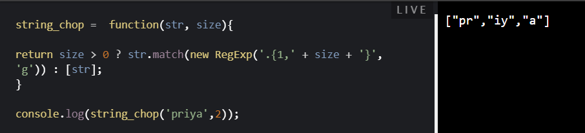
capitalize = function(str1){
return str1.charAt(0).toUpperCase() + str1.slice(1);
}
console.log(capitalize('js string exercises'));
Object Destructuring:
var object={name:"xyz", age:43, id:3}
const {name, age,id} = object

Slide 66
Lexical scoping (sometimes known as static scoping ) is a convention used with many programming languages that sets the scope (range of functionality) of a variable so that it may only be called (referenced) from within the block of code in which it is defined. The scope is determined when the code is compiled. A variable declared in this fashion is sometimes called a private variable.
We use call, bind and apply methods to set the this keyword independent of how the function is called. This is especially useful for the callbacks (as in the above example).
Bind:
const obj = {
name: 'John',
age: 24,
};
function greeting()
{
console.log(`Hi, I am ${this.name} and I am ${this.age} years old`);
}
const greetingJohn = greeting.bind(obj);
greetingJohn();
Call:
const obj = {
name: 'John',
age: 24,
};
function greeting() {
console.log(`Hi, I am ${this.name} and I am ${this.age} years old`);
}
greeting.call(obj);
Apply:
const obj = {
name: 'John',
age: 24,
};
function greeting(greet)
{
console.log(`${greet}, I am ${this.name} and I am ${this.age} years old`);
}
greeting.apply(obj, ['Hi']);

Slide 67
A polyfill is a browser fallback, made in JavaScript, that allows functionality you expect to work in modern browsers to work in older browsers, e.g., to support canvas (an HTML5 feature) in older browsers.
The debounce() function forces a function to wait a certain amount of time before running again. The function is built to limit the number of times a function is called. ... The function aims to reduce overhead by preventing a function from being called several times in succession.
Debounce and throttle are two similar (but different!) techniques to control how many times we allow a function to be executed over time.
What is Peer dependency in react?
Having a peer dependency means that your package needs a dependency that is the same exact dependency as the person installing your package. This is useful for packages like react that need to have a single copy of react-dom that is also used by the person installing it.
function findLongestWord(str) {
var strSplit = str.split(' ');
var longestWord = 0;
for(var i = 0; i < strSplit.length; i++){
if(strSplit[i].length > longestWord){
longestWord = strSplit[i].length;
}
}
return longestWord;
}
console.log(findLongestWord("Priya Ram shyam hellious uaaaaaaaaaaa"));
function findLongestWord(str) {
var longestWord = str.split(' ').sort(
function(a, b) { return b.length - a.length; });
return longestWord[0];
}
console.log(findLongestWord("Priya Ram shyam hellious uaaaaaaaaaaa"));

Slide 68
Some dependencies are needed to build your project, others are needed when you’re running your program. As such there are a number of different types of dependencies that you can have (e.g. dependencies, devDependencies, and peerDependencies).
dependencies
These are your normal dependencies, or rather ones that you need when running your code (e.g. React or ImmutableJS).
devDependencies
These are your development dependencies. Dependencies that you need at some point in the development workflow but not while running your code (e.g. Babel or Flow).
peerDependencies
Peer dependencies are a special type of dependency that would only ever come up if you were publishing your own package.
Having a peer dependency means that your package needs a dependency that is the same exact dependency as the person installing your package. This is useful for packages like react that need to have a single copy of react-dom that is also used by the person installing it.
ESLint - Pluggable JavaScript linter
eslint.org
A pluggable and configurable linter tool for identifying and reporting on patterns in JavaScript. Maintain your code quality with ease.
Meet ESLint, a tool that allows you to automatically detect incorrect patterns in JavaScript.
getDerivedStateFromProps exists only to enable a component to update its internal state as a result of changes in props. Keeping copy of past value is called memoization. To avoid misuse of “this” and memoization, getDerivedStateFromProps is made static.
The reason getDerivedStateFromProps is static is to discourage any side-effects during the render phase. For example, updating or using props on the instance. This isn't safe anymore with the upcoming async rendering. It is called when a component is created and each time it recieves a new props.

Slide 69
import React, { Component } from "react";
import axios from "axios";
export default class TodoListClassComponent extends Component {
constructor(props) {
super(props);
this.state = {
nextTodoId: 0,
newTodoLabel: ""
};
}
componentDidMount() {
axios
.get(
"https://gist.githubusercontent.com/witalewski/fc8f043d53a0d505f84c5ddb04ae76ea/raw/7c505bbc1675a0bc8a067f8b633b531c769bb64c/data.json"
)
.then(({ data }) => {
this.setState({ todos: data });
this.setState({ nextTodoId: data.length });
});
}
markTodoAsDone = (id, done) =>
this.setState({
todos: this.state.todos.map(todo =>
todo.id === id ? { ...todo, done } : todo
)
});
removeTodo = id =>
this.setState({
todos: this.state.todos.filter(todo => todo.id !== id)
});
addNewTodo = () =>
this.setState({
todos: [
...this.state.todos,
{https://itnext.io/add-state-and-lifecycle-methods-to-function-components-with-react-hooks-8e2bdc44d43d
id: this.state.nextTodoId,
label: this.state.newTodoLabel,
done: false
}
],
nextTodoId: this.state.nextTodoId + 1,
newTodoLabel: ""
});
render() {
const { todos, newTodoLabel } = this.state;
return todos ? (
<div className="todo-list">
<ul>
{todos.map(todo => (
<li key={todo.id}>
<input
type="checkbox"
checked={todo.done}
onChange={({ target }) =>
this.markTodoAsDone(todo.id, target.checked)
}
label={todo.label}
/>
<span className={todo.done ? "done" : ""}>{todo.label}</span>
<button onClick={() => this.removeTodo(todo.id)}>X</button>
</li>
))}
</ul>
<div className="new-todo">
<input
type="text"
value={newTodoLabel}
onChange={({ target }) =>
this.setState({ newTodoLabel: target.value })
}
/>
<button onClick={this.addNewTodo}>Add</button>
</div>
</div>
) : (
<div>Loading...</div>
);
}
}
https://itnext.io/add-state-and-lifecycle-methods-to-function-components-with-react-hooks-8e2bdc44d43d

Slide 70
useEffect(() => {
fetch(url)
.then(resp => resp.json())
.then(data => this.setState()
}, [])
Passing [] as the second argument, useEffect to behave like componentDidMount as this tells useEffect that your effect isn’t dependent on any values from props or state thus never re-running. By default useEffect() would run on every update on the component but by passing an array of dependencies, in this case no dependencies so it never runs again.
By adding dependencies for example:
*A prototype is something all JavaScript objects inherit properties (variables in an object) and methods (functions in an object) from. For instance, Array objects inherit from Array.prototype.
for-in
A for-in statement creates a loop that iterates over all non-Symbol, enumerable properties of an object, sometimes in an arbitrary order.
for (property in object) {
// Do stuff
}
for-of
Introduced in ES6, a for-of statement creates a loop that iterates over iterable objects (see below for clarification) in iterable order. A common use is looping through values in an array, but it also works on most array-like objects.
for (item of iterable) {
// Do stuff
}
It has considerable benefits over for-in and forEach():
Unlike forEach(), you can use break, continue, and return
Two key advantages over for-in: one, it visits indices of an array in numeric (ascending) order, and two, indices of arrays are not converted to strings, so you can perform arithmetic

Slide 71
The For Loop
for (i = 0; i < 10; i++) {
// do something
}
Our for loop consists of three statements, one that is executed before our loop starts ( i = 0 ), one that defines how long our loop should run ( i < 10 ), and one that is executed after each loop ( i++ ).
ForEach
forEach is an Array method that we can use to execute a function on each element in an array. It can only be used on Arrays, Maps, and Sets.
const arr = ['cat', 'dog', 'fish'];arr.forEach(element => {
console.log(element);
});
const arr = ['cat', 'dog', 'fish'];for (i = 0; i < arr.length; i++) {
console.log(arr[i])
}
For…In
Here’s what the for...in syntax looks like:
for (variable in object) {
// do something
}
for...in is used to iterate over the enumerable properties of objects. Every property in an object will have an Enumerable value — if that value is set to true, then the property is Enumerable.
const obj = {
a: 1,
b: 2,
c: 3,
d: 4
}
for (let elem in obj) {
console.log( obj[elem] )
}// 1
// 2
// 3
// 4
Better yet, we can log out both the key and value pair:
for (let elem in obj) {
console.log(`${elem} = ${obj[elem]}`);
}

Slide 72
the difference between for-in and for-of lies in the data structure they iterate over. for-in iterates over enumerable objects whereas for-of iterates over iterable objects”
The forEach() prototype* method, introduced in ES5, executes a provided callback function (a function passed to another function as an argument) once for each value in Array
you can’t use the statements break to exit the loop, continue to skip an iteration, or return to return a value (and exit the loop).
The for and for/in looping constructs give you access to the index in the array, not the actual element.
With the other two constructs, forEach() and for/of, you get access to the array element itself. With forEach() you can access the array index i, with for/of you cannot.
for (let i = 0; i < arr.length; ++i) { console.log(arr[i]); } for (let i in arr) { console.log(arr[i]); }
arr.forEach((v, i) => console.log(v)); for (const v of arr) { console.log(v); }
forEach() and for/in skip empty elements in the array, for and for/of do not.

Slide 73
The some() method tests whether at least one element in the array passes the test implemented by the provided function. It returns a Boolean value.
The find() method returns the value of the first element in the provided array that satisfies the provided testing function. If no values satisfies the testing function, undefined is returned.
using .find() states that you are looking for one particular array item. As for .some() , you are clearly checking if the array contains items that fit your needs or not.
Prototypes allow you to easily define methods to all instances of a particular object. The beauty is that the method is applied to the prototype, so it is only stored in the memory once, but every instance of the object has access to it.
Destructuring simply implies breaking down a complex structure into simpler parts. In JavaScript, this complex structure is usually an object or an array. With the destructuring syntax, you can extract smaller fragments from arrays and objects.
var hero = { name: 'Batman', realName: 'Bruce Wayne' }; var name = hero.name;var realName = hero.realName; name; // => 'Batman', realName; // => 'Bruce Wayne'
const name = hero.name; const realName = hero.realName; // is equivalent to:
const { name, realName } = hero;
Throttling enforces a maximum number of times a function can be called over time. As in “execute this function at most once every 100 milliseconds.” ...
Debouncing enforces that a function not be called again until a certain amount of time has passed without it being called.

Slide 74
class Vehicle {
constructor (name, type) {
this.name = name;
this.type = type;
}
getName () {
return this.name;
}
getType () {
return this.type;
}
}let car = new Vehicle('Tesla', 'car');
console.log(car.getName()); // Tesla
console.log(car.getType()); // car
function Vehicle (name, type) {
this.name = name;
this.type = type;
};
Vehicle.prototype.getName = function getName () {
return this.name;
};
Vehicle.prototype.getType = function getType () {
return this.type;
};function Car (name) {
Vehicle.call(this, name, ‘car’);
}Car.prototype = Object.create(Vehicle.prototype);
Car.prototype.constructor = Car;
Car.parent = Vehicle.prototype;
Car.prototype.getName = function () {
return 'It is a car: '+ this.name;
};var car = new Car('Tesla');
console.log(car.getName()); // It is a car: Tesla
console.log(car.getType()); // car
IIFEs are very useful because they don't pollute the global object, and they are a simple way to isolate variables declarations.
The preventDefault() method is used to prevent the browser from executing the default action of the selected element.

Slide 75
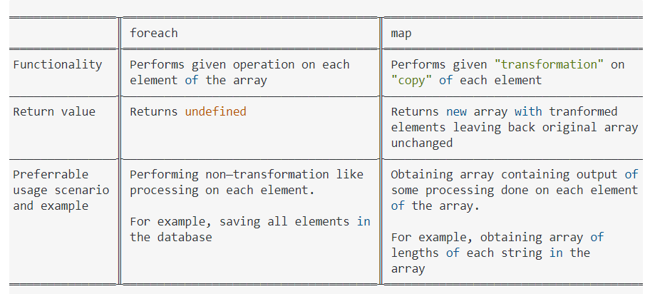
To update our state, we use this.setState() and pass in an object. This object will get merged with the current state. When the state has been updated, our component re-renders automatically.

Slide 76
Style.css
.App {
font-family: sans-serif;
text-align: center;
}
table {
display: flex;
justify-content: center;
border: 1px solid rgb(128, 128, 128);
}
td {
border: 1px solid gray;
width: 30em;
}
th {
border: 1px solid gray;
width: 30em;
}
App.js
import "./styles.css";
import React from "react";
import { connect } from "react-redux";
import { anotherName } from "./Action";
import { BrowserRouter, Switch, Route } from "react-router-dom";
import Login from "./Login";
import Welcome from "./Welcome";
export default class App extends React.Component {
render() {
return (
<div>
<div>
<BrowserRouter>
<Switch>
<Route exact path="/" component={Login} />
<Route exact path="/welcome/:username" component={Welcome} />
<Route exact path="/logout" component={Login} />
</Switch>
</BrowserRouter>
</div>
<div>
{/*<h1>My name is {props.myname}</h1>
<button onClick={() => {props.changeName();}}>Change Name</button>
*/}
</div>
</div>
);
}
}
Login.js
import React from "react";
import "./styles.css";
import { withRouter } from "react-router-dom";
class Login extends React.Component {
constructor() {
super();
this.state = {
err: ""
};
this.login = this.login.bind(this);
}
login(e) {
e.preventDefault();
var username = e.target.elements.username.value;
var password = e.target.elements.password.value;
if (username==="nectar123@gmail.com" && password==="nectar123") {
this.props.history.push("/welcome/" + username);
} else {
this.setState((er) => {
return { err: "Invalid" };
});
}
}
render() {
return (
<div>
<h3>Login</h3>
<span style={{ color: "red" }}>
{this.state.err !== "" ? this.state.err : ""}
</span>
<form method="post" onSubmit={this.login.bind(this)}>
Username: <input type="text" name="username" />
Password: <input type="password" name="password" />
<button type="submit" value="Login">
Login Please
</button>
</form>
</div>
);
}
}
export default withRouter(Login);
Welcome.js
import React from "react";
import "./styles.css";
import data from "./data";
export default class Welcome extends React.Component {
logout() {
this.props.history.push("/logout");
}
render() {
const { username } = this.props.match.params;
console.log(username);
return (
<div className="App">
<h4 style={{ display: "inline" }}> Welcome {username}</h4>{" "}
<button style={{ display: "inline" }} onClick={this.logout.bind(this)}>
Logout
</button>
<div>
{data.map((postDetail, index) => {
return (
<div>
{/*<h3>{postDetail.id}</h3>
<h3>{postDetail.name}</h3>
<h3>{postDetail.age}</h3>
<h3>{postDetail.gender}</h3>
<h3>{postDetail.email}</h3>
<h3>{postDetail.phoneNo}</h3>
<hr />*/}
<table>
<thead></thead>
<tbody>
<tr>
<td>
<h3>{postDetail.id}</h3>
</td>
<td>
<h3>{postDetail.name}</h3>
</td>
<td>
<h3>{postDetail.age}</h3>
</td>
<td>
<h3>{postDetail.gender}</h3>
</td>
<td>
<h3>{postDetail.email}</h3>
</td>
<td>
<h3>{postDetail.phoneNo}</h3>
</td>
</tr>
</tbody>
</table>
</div>
);
})}
</div>
</div>
);
}
}
Data.json
[
{
"id": "1",
"name": "test1",
"age": "11",
"gender": "male",
"email": "test1@gmail.com",
"phoneNo": "9111111111"
},
{
"id": "2",
"name": "test2",
"age": "12",
"gender": "male",
"email": "test2@gmail.com",
"phoneNo": "9222222222"
},
{
"id": "3",
"name": "test3",
"age": "13",
"gender": "male",
"email": "test3@gmail.com",
"phoneNo": "9333333333"
},
{
"id": 4,
"name": "test4",
"age": 14,
"gender": "male",
"email": "test4@gmail.com",
"phoneNo": "9444444444"
},
{
"id": 5,
"name": "test5",
"age": "15",
"gender": "male",
"email": "test5@gmail.com",
"phoneNo": "9555555555"
},
{
"id": 6,
"name": "test6",
"age": "16",
"gender": "male",
"email": "test6@gmail.com",
"phoneNo": "9666666666"
}
]

Slide 77
An anonymous function is a function that was declared without any named identifier.
Functions stored in variables do not need function names.
algorithms are simply a series of instructions that are followed, step by step, to do something useful or solve a problem
Test Driven Development (TDD) is software development approach in which test cases are developed to specify and validate what the code will do. ... TDD instructs developers to write new code only if an automated test has failed. This avoids duplication of code. The full form of TDD is Test-driven development.
What is the difference between PX, EM and Percent? Pixel is a static measurement, while percent and EM are relative measurements

Slide 78
Ranjan Acharya
4:05 PM
console.log(sum(2,3)); // Outputs 5 console.log(sum(2)(3)); // Outputs 5
Ranjan Acharya
4:10 PM
(function() { console.log(1); setTimeout(function(){console.log(2)}, 1000); setTimeout(function(){console.log(3)}, 0); console.log(4); })();
Ranjan Acharya
4:12 PM
console.log(typeof null)
typeof typeof 1
Ranjan Acharya
4:14 PM
for (var i = 0; i < 5; i++) { setTimeout(function() { console.log(i); }, i * 1000 ); }
Ranjan Acharya
4:15 PM
for (var i = 0; i < 5; i++) { setTimeout(function() { console.log(i); }, 1000 ); }
Ranjan Acharya
4:27 PM
console.log(1 < 2 < 3); console.log(3 > 2 > 1);
Ranjan Acharya
4:32 PM
export default [ { name: " William", location: " Lagos", car: "Honda" }, { name: " Chris", location: " Moon", car: "Tesla" }, { name: "Rose", location: "Venice", car: "Pagani" } ];

Slide 79
console.log(3<2<1)//true
console.log(1>2>3)//false
function sum(x, y) {
if (y === undefined)
{
return function (y)
{
return x + y;
};
}
else
{
return x+y;
}
}
console.log(sum(2)(3))
console.log(sum(3,3))
console.log(typeof typeof 1) //string
(function()
{
console.log(1);
setTimeout(function(){console.log(2)}, 1000);
setTimeout(function(){console.log(3)}, 0);
console.log(4);
}
)(); //1,4,3,2
for (var i = 0; i < 5; i++) { setTimeout(function() { console.log(i); }, i * 1000 ); } //5,5,5,5,5
this.state.data.map(
(d)=>(
<li key={d.id}>{d..name}</li>
<li key={d.id}>{d.location}</li>
<li key={d.id}>{d.car}</li>
)
)
https://github.com/learning-zone/javascript-interview-questions/blob/master/javascript-programs.md
console.log(+"meow"); // Output: NaN
console.log(0.1 + 0.2 == 0.3); // Output: false
console.log(1 + -"1" + 2); // Output: 2

Slide 80
var myArray = [ { field: "id", operator: "eq" }, { field: "cStatus", operator: "eq" }, { field: "money", operator: "eq" }, ]; myArray = myArray.filter(function (obj) { return obj.field !== "money"; }); Console.log(myArray);
To check if object is empty or not:::: function isEmpty(obj) { return Object.keys(obj).length === 0; }
Comparison of 2 objects:: const k1 = { fruit: "🥝" }; const k2 = { fruit: "🥝" }; // Using JavaScript JSON.stringify(k1) === JSON.stringify(k2); // true
function reverseString(str) { let stringRev = ""; for (let i = str.length; i >= 0; i--) { stringRev = stringRev + str.charAt(i); } return stringRev; } alert(reverseString("Pradeep")); // Output: peedarP
ComponentWillUnmount in useEffect
Asyn/Await and Promises
React.js and Redux state
Context
TDD
Agile
Custom hook
Design Pattern
Light and dark theme
Call by value and reference
Filter vs map
Create an element
Dynamic routing
Location.history
HOC implementation
Object clone
Create an object
Ways of accessing object property
Unit test case-enzyme, mocha,ava
Html validations
Attribute pattern
22. email validation
RestFull API
Window and global object
State in functions
Time complexity
Space complexity
Javascript class
Foo bar code
React 17.0 new features
Color vs background color
useEffect hooks
Purpose of middlewarae
Thunk?
setTimeOut
Flex
componentDidMount
Render props
Media query
preventDefault
Parameter of useEffect
Setinterval
Object assign
Object mutation
Padding
Center allignent
Inheritence
Template literal
GIT repository
Reducer in functional component
SASS AND SCSS
[] array
seState second parameter
Encasulation in react.js
JWT
Object oriented
Pseddo classand elements
Box sizing
Padding
useSelector
Own middleware
Find and some

Slide 81
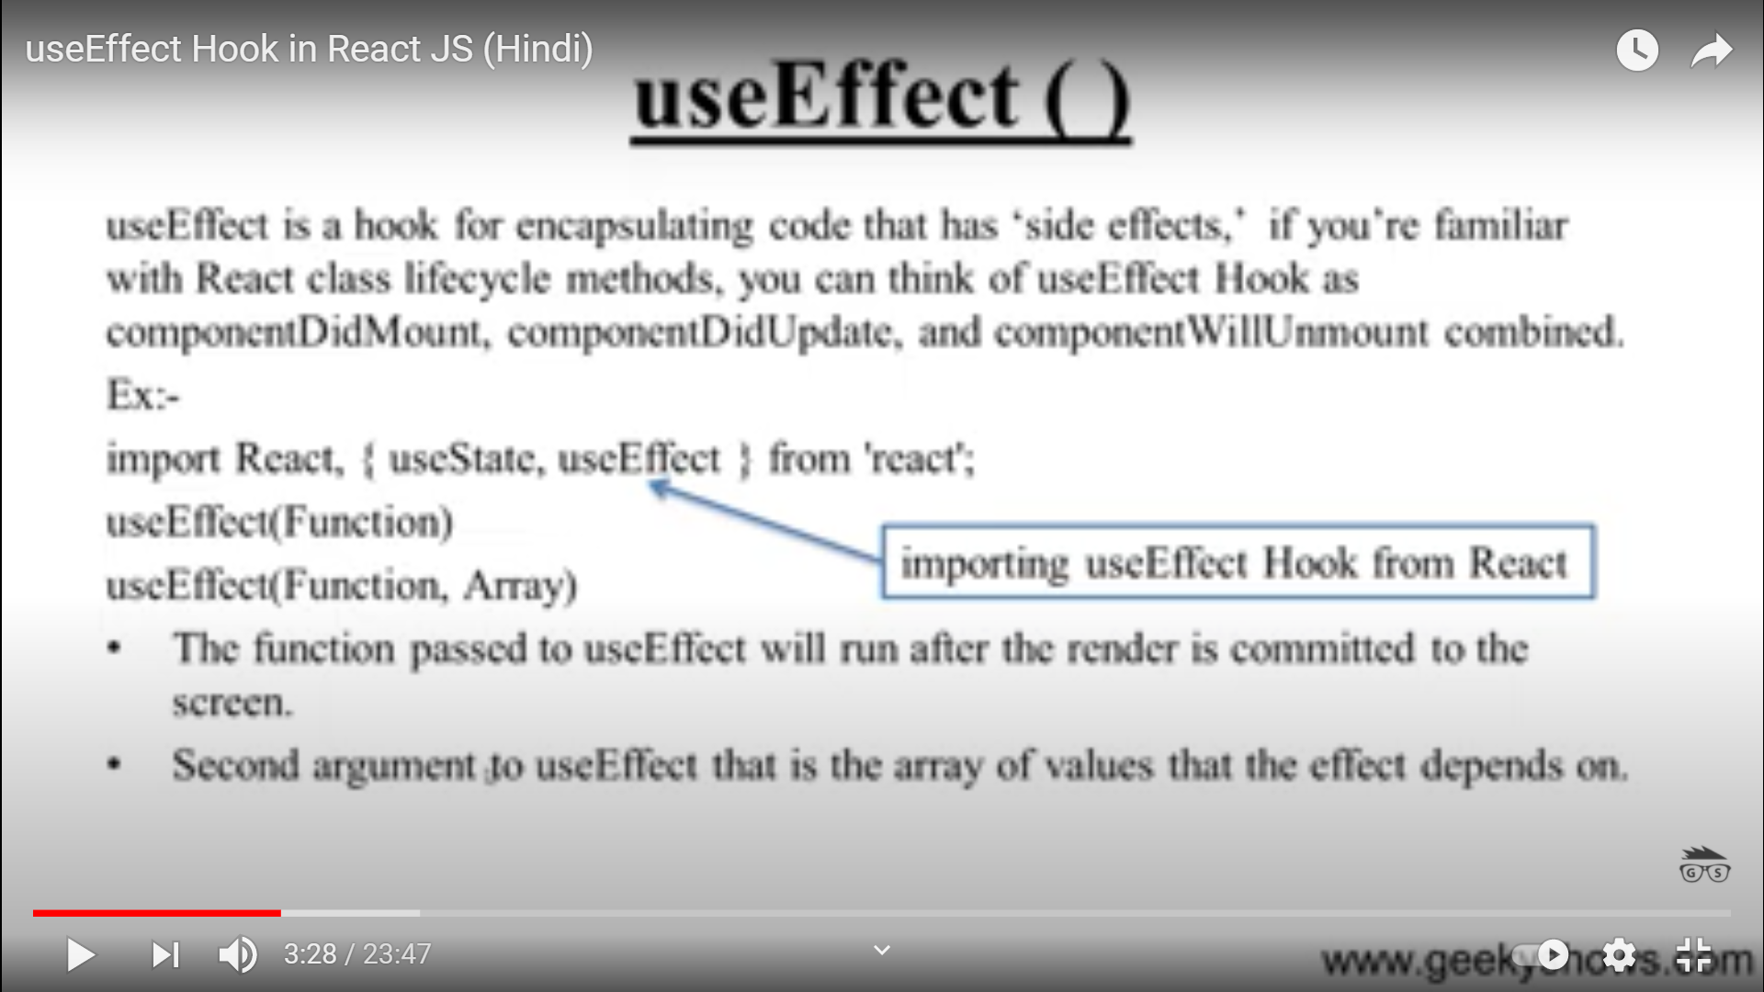

Slide 82
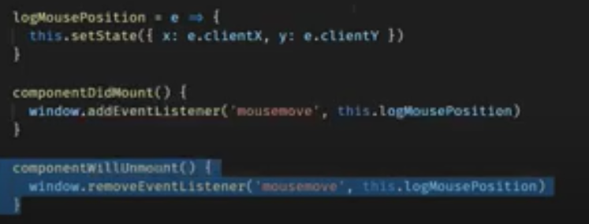
componentWillUnmount() is invoked immediately before a component is unmounted and destroyed. Perform any necessary cleanup in this method, such as invalidating timers, canceling network requests, or cleaning up any subscriptions that were created in componentDidMount()
useEffect(() => {
window.addEventListener('mousemove', () => {});
// returned function will be called on component unmount
return () => {
window.removeEventListener('mousemove', () => {})
}
}, []) //clean up in useEffect as like componentwullunmount
componentWillUnmount() is called when a component is being removed from the DOM.
As per react hooks rule whenever an effect received a return function it runs only at the time of cleanup of the component. Also you know that effect runs everytime component renders if you pass a dependency to useEffect in that case the cleanup will run and react will cleans up the function before rendering it next time.
1. Callbacks (ES5)
2. Promises (ES6)
3. Async / Await (ES7: still draft)

Slide 83
div.middle { width: 100px; height: 100px; background-color: red; position: absolute; margin: auto; top:0; bottom: 0; left: 0; right: 0; } div.leftTop { float:left; width: 100px; height: 100px; background-color: yellow; } div.rightTop{ float:right; width: 100px; height: 100px; background-color: blue; } div.leftBottom{ width: 100px; height: 100px; background-color: green; left: 0; bottom: 0; position: absolute; } div.rightBottom{ float:right; width: 100px; height: 100px; background-color: orange; right: 0; bottom: 0; position: absolute; } h5 { text-align: center; }
Async/await can help make your code cleaner and more readable in cases where you need complicated control flow. It also produces more debug-friendly code. And makes it possible to handle both synchronous and asynchronous errors with just try/catch.
Promise creation starts the execution of asynchronous functionality. await only blocks the code execution within the async function. It only makes sure that the next line is executed when the promise resolves. So, if an asynchronous activity has already started, await will not have any effect on it.
<div class=leftTop><h5>sona</h5></div> <div class=rightTop><h5>mona</h5></div> <div class=middle><h5>priya</h5></div> <div class=leftBottom><h5>sonal</h5></div> <div class=rightBottom><h5>priyal</h5></div>
React state is stored locally within a component. When it needs to be shared with other components, it is passed down through props.
Custom hooks:
Custom hooks are nothing but these are javascript functions, while creating a react app, if we have something common logic that we want to share between components then we use custom hooks. These are logic that will be reused in many components. We create a different function and write a shared logic here. We can create hooks using the name start with “use” keyword.
When using Redux, state is stored globally in the Redux store. Any component that needs access to a value may subscribe to the store and gain access to that value.
allow you to abstract logic for your components making it easier to reuse across multiple components in your app.

Slide 84
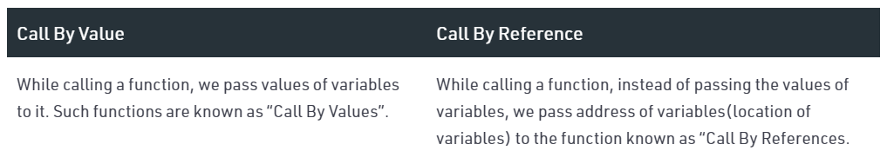
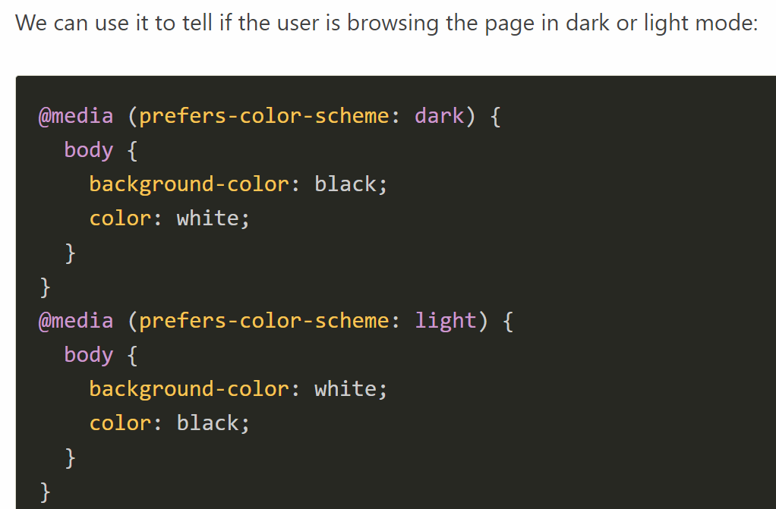
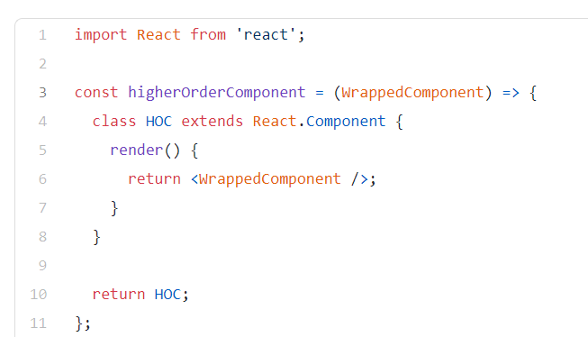
Types of Design Patterns(Behavioral, Creational, Structural) Distinguish between Behavioral, Creational, and Structural Design Patterns
a design pattern is a general repeatable solution to a commonly occurring problem in software design. A design pattern isn't a finished design that can be transformed directly into code. It is a description or template for how to solve a problem that can be used in many different situations.
In static routing routes, the path is updated by the user or an administrator while in dynamic routing, routes are updated automatically. Static Routing does not use any routing protocols and algorithms while dynamic routing uses routing protocols and complex algorithms to calculate routing operations.

Slide 85
The second parameter to setState() is an optional callback function that will be executed once setState is completed and the component is re-rendered. componentDidUpdate should be used instead to apply such logic in most cases.
Redux middleware provides a third-party extension point between dispatching an action, and the moment it reaches the reducer. People use Redux middleware for logging, crash reporting, talking to an asynchronous API, routing, and more.
Redux Thunk middleware allows you to write action creators that return a function instead of an action. The thunk can be used to delay the dispatch of an action, or to dispatch only if a certain condition is met. The inner function receives the store methods dispatch and getState as parameters.
Both Redux Thunk and Redux Saga take care of dealing with side effects. In very simple terms, applied to the most common scenario (async functions, specifically AJAX calls) Thunk allows Promises" to deal with them, Saga uses Generators.
Media queries are a feature of CSS that enable webpage content to adapt to different screen sizes and resolutions. They are a fundamental part of responsive web design and are used to customize the appearance of websites for multiple devices.
useEffect() functions are run on every subsequent re-render/update, we can tell React to skip a run, for performance purposes, by adding a second parameter which is an array
Objects are mutable in JavaScript. As I told above, objects are reference typed data. Therefore, they contains the reference to the value. This reference points to the object’s memory location.
On the basis of the part of URL that the router will use to track the content that the user is trying to view, React Router provides three different kinds of routers: Memory Router. Browser Router. Hash Router.

Slide 86
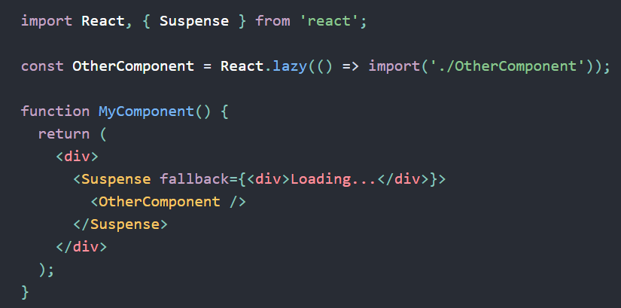
There are two types of router components:
<BrowserRouter>: It is used for handling the dynamic URL.
<HashRouter>: It is used for handling the static request.
MemoryRouter
Chaining Methods, also known as Cascading, refers to repeatedly calling one method after another on an object, in one continuous line of code.
In a cascade, we can call many methods on the same object in sequence in a single statement.
What are Pseudo-classes?
A pseudo-class is used to define a special state of an element.
For example, it can be used to:
Style an element when a user mouses over it
Style visited and unvisited links differently
Style an element when it gets focus
regex accepts a certain set of strings and rejects the rest.
A regular expression is a sequence of characters that define a search pattern.
Selectors are the part of CSS rule set. CSS selectors select HTML elements according to its id, class, type, attribute etc.
div:hover {
background-color: blue;
}

Slide 87
What are Pseudo-Elements?
A CSS pseudo-element is used to style specified parts of an element.
For example, it can be used to:
Style the first letter, or line, of an element
Insert content before, or after, the content of an elemen
p::first-line {
color: #ff0000;
font-variant: small-caps;
}

